Slide 1
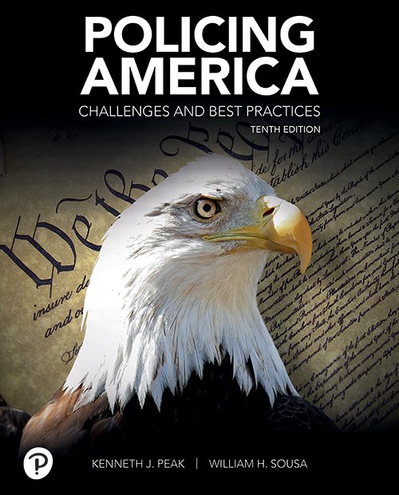
Policing America: Challenges and Best Practices
Tenth Edition
Chapter 4
Community Policing: “Guardians,” or “Soldiers”?
Copyright © 2021, 2018, 2015, 2012 Pearson Education, Inc. All Rights Reserved
Notes:
If this PowerPoint presentation contains mathematical equations, you may need to check that your computer has the following installed:
1) MathType Plugin
2) Math Player (free versions available)
3) NVDA Reader (free versions available)

Slide 2
Lessons from History and Ferguson: A Brief Reflection
Long history of poor relations between police and minority communities
Major race riots during the 1960s, and those in the late 1980s and early 1990s
  Police pitted against protesters
Racial profiling/bias-based policing

Slide 3
How to Achieve Harmony, Justice, and Policy?
Recruit and diversify police agencies
Stop blurring the lines between police and the military
Begin wearing body cameras
Increased academy training in community policing
More information about officer-involved shootings at the national level

Slide 4
A Change in Police Mindset
The need for police to build trusting relationships is a critical challenge
The inability to handle officer misconduct impacts integrity, professionalism, and trust
The need to embrace the “guardian” mindset, rather than the “soldier” mindset

Slide 5
Calls for Police Body Cameras
Emphasis on greater police transparency includes call for officers to wear body cameras
Key questions
  When should they be used
  Who should be allowed to view which kinds of footage?

Slide 6
Basic Principles of Community Policing
Community can/must play a vital role in problem solving and crime fighting
Address crime control through a working partnership with the community
Long-term process involving fundamental change
Requires cultural transformation of agency

Slide 7
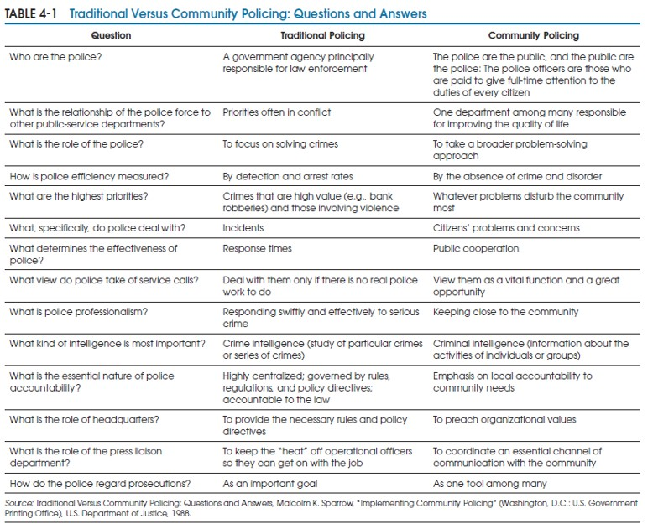
Table 4-1 Traditional Versus Community Policing: Questions and Answers
Notes:
Long description:
Traditional Policing
Who are the police? A government agency principally responsible for law enforcement
What is the relationship of the police force to other public-service departments? Priorities often in conflict
What is the role of the police? To focus on solving crimes
How is police efficiency measured? By detection and arrest rates
What are the highest priorities? Crimes that are high value (e.g., bank robberies) and those involving violence
What, specifically, do police deal with? Incidents
What determines the effectiveness of police? Response times
What view do police take of service calls? Deal with them only if there is no real police work to do
What is police professionalism? Responding swiftly and effectively to serious crime
What kind of intelligence is most important? Crime intelligence (study of particular crimes
or series of crimes)
What is the essential nature of police accountability?
Highly centralized; governed by rules, regulations, and policy directives; accountable to the law
What is the role of headquarters? To provide the necessary rules and policy directives
What is the role of the press liaison department? To keep the “heat” off operational officers so they can get on with the job
How do the police regard prosecutions? As an important goal.
Community Policing
Who are the police? The police are the public, and the public are the police: The police officers are those who are paid to give full-time attention to the duties of every citizen
What is the relationship of the police force to other public-service departments? One department among many responsible for improving the quality of life
What is the role of the police? To take a broader problem-solving
approach
How is police efficiency measured? By the absence of crime and disorder
What are the highest priorities? Whatever problems disturb the community most
What, specifically, do police deal with? Citizens’ problems and concerns
What determines the effectiveness of police? Public cooperation
What view do police take of service calls? View them as a vital function and a great opportunity
What is police professionalism? Keeping close to the community
What kind of intelligence is most important? Criminal intelligence (information about the activities of individuals or groups)
What is the essential nature of police accountability? Emphasis on local accountability to community needs
What is the role of headquarters? To preach organizational values
What is the role of the press liaison department? To coordinate an essential channel of communication with the community
How do the police regard prosecutions? As one tool among many.

Slide 8
A Necessary Extension: Problem-Oriented Policing (1 of 2)
Problem solving for police not new
Routine application of problem-solving techniques is new
Based on two facts
  Problem solving can be applied by officers throughout the agency
  Routine problem-solving efforts can be effective in reducing/resolving problems

Slide 9
A Necessary Extension: Problem-Oriented Policing (2 of 2)
P O P is a strategy that puts C O P philosophy into practice
Police examine underlying causes of recurring crime incidents
Police take more formalized, organized view of incidents

Slide 10
The Problem-Solving Process: SARA
P O P involves a four-stage problem-solving process (SARA)
  Scanning
  Analysis
  Response
  Assessment

Slide 11
Scanning: Problem Identification (1 of 2)
Officers identify problems on their beats and look for pattern or persistent repeat incidents
Problem: group of 2+ similar incidents that cause harm
Purpose of scanning: conduct preliminary inquiry to determine if a problem exists and whether further analysis is needed

Slide 12
Scanning: Problem Identification (2 of 2)
Similarities among incidents include:
  Behaviors
  Locations
  People
  Time
  Events

Slide 13
Analysis: Heart of Problem Solving
Officers seek information about crime problem
Cannot develop effective responses to a problem without knowing what is causing it
Identify seriousness of problem, know individuals/groups involved and affected, list causes of problem, assess current responses

Slide 14
Methods of Analysis
Problem-analysis triangle
  Helps officers visualize and understand a problem’s three elements: offender, victim, location
Computerized crime mapping and offense reports
C F S analysis
  Reveal hot spots of crime and disturbances

Slide 15
Response: Formulation of Tailor-Made Strategies
Ultimate challenge in P O P
  Search for most effective way of dealing with a problem
Focus is on developing and implementing responses to problem
Important to avoid the “quick fix”

Slide 16
Assessment: Evaluation of Overall Effectiveness
Evaluate effectiveness of responses
Measures: number of arrests, levels of reported crime, response times, clearance rates, citizen complaints, workload indicators
Other measures: decreases in related crimes, increased citizen satisfaction, reduced citizen fear

Slide 17
Broader Role for the Street Officer
In P O P, the line officer is given more discretion and decision-making ability, broader range of responsibilities
P O P values “thinking” officers
Officers do more than just handle calls

Slide 18
CompStat (1 of 2)
Designed for the collection and feedback of information on crime and related quality-of-life issues
Over half of large agencies adopted / are planning to adopt CompStat
Key elements:
  Specific objectives; accurate and timely intelligence; effective tactics; rapid deployment; follow-up and assessment

Slide 19
CompStat (2 of 2)
Police think proactively about ways to deal with crime
CompStat believed to have played major role in significant crime reductions in U.S.

Slide 20
Crime Prevention
Important corollary of community policing and problem-solving
  Preferable/cheaper to prevent crime than to solve it
  Focus on crime prevention shifts police agency’s purpose
At its heart, community policing (and problem solving) is about preventing crime

Slide 21
Crime Prevention through Environmental Design (1 of 3)
C P T E D
  The “proper design and effective use of the environment that can lead to a reduction in the fear and incidence of crime and an improvement in the quality of life”
Notes:
C. R. Jeffrey, Crime Prevention Through Environmental Design (Beverly Hills, CA: Sage, 1971), p. 117.

Slide 22
Crime Prevention through Environmental Design (2 of 3)
Three key principles
  Natural access control
  Natural surveillance
  Territorial reinforcement

Slide 23
Crime Prevention through Environmental Design (3 of 3)
C P T E D planning requires five types of information
  Crime analysis information
  Demographics
  Land use information
  Observations
  Resident information

Slide 24
Repeat Victimization (1 of 2)
Underlying premise
  If the police want to know where a crime will occur next, they should look at where it happened last
Need to incorporate R V knowledge into formal crime-prevention efforts

Slide 25
Repeat Victimization (2 of 2)
R V is arguably the best single predictor routinely available to the police
A small number of victims accounts for a disproportionate number of victimizations

Slide 26
An Emerging Paradigm: Smart Policing
Emphasis on use of data and analytics, improved crime analysis, performance measurement, evaluation research
Key element is police/researcher partnership
Focus on developing a stronger base of evidence in policing
Call for more sophisticated research designs when evaluating police strategies

Slide 27
How it Works: An Array of Strategies and Tactics (1 of 2)
S P I has produced an impressive array of strategies and tactics
  Hot spot and place-based strategies
  Offender-based approaches
  Applications of the S A R A problem-solving model
  Applications of community policing
  Technological approaches

Slide 28
How it Works: An Array of Strategies and Tactics (2 of 2)
Results thus far are promising:
  S P I initiatives have reduced violent crime
  S P I initiatives have reduced service calls and property crime
  S P I initiatives are examining the impact of body-worn cameras on police
  S P I initiatives are testing innovations in intelligence-led and predictive policing

Slide 29
Community Policing and Cybercrime
Cybercrime
  Involves electronic manipulation of data
  Related offenses include identity theft, cyber stalking, child pornography, cyberbullying, embezzlement, theft, fraud
SARA can be used to address cybercrime

Slide 30

Copyright
This work is protected by United States copyright laws and is provided solely for the use of instructors in teaching their courses and assessing student learning. Dissemination or sale of any part of this work (including on the World Wide Web) will destroy the integrity of the work and is not permitted. The work and materials from it should never be made available to students except by instructors using the accompanying text in their classes. All recipients of this work are expected to abide by these restrictions and to honor the intended pedagogical purposes and the needs of other instructors who rely on these materials.

